Slide 1
South End Community Day Care
Aleysha Mullen
Angela Dini
Azeem Ali
Negin Sauermann
Rami Khashmelmous

Slide 2
Project Overview

Slide 3
Client Requests

Slide 4
Why WordPress?

Slide 5
Scope

Slide 6
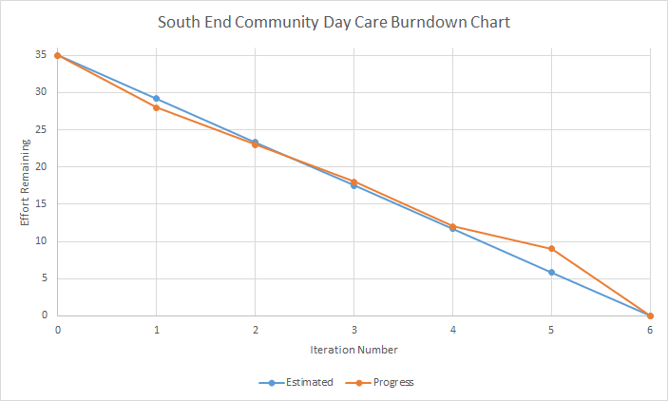
Summary of Progress

Slide 7
How did we meet client needs?

Slide 8
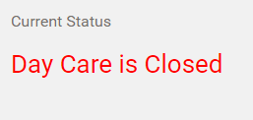
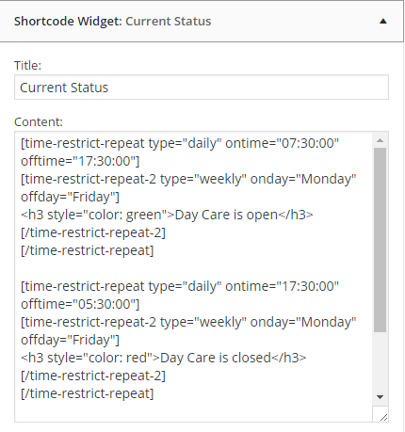
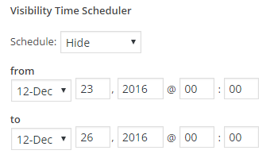
Daycare Status

Slide 9
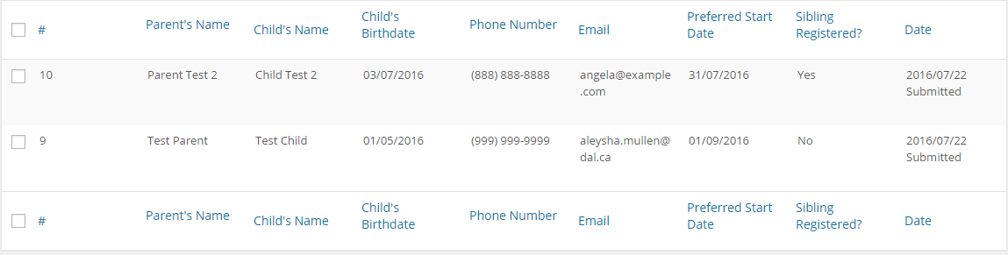
Waiting List

Slide 10
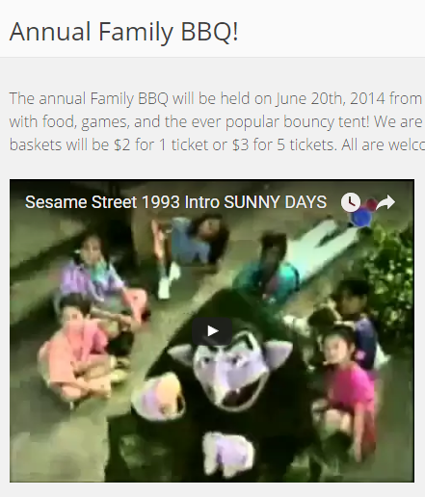
Video Embedding

Slide 11
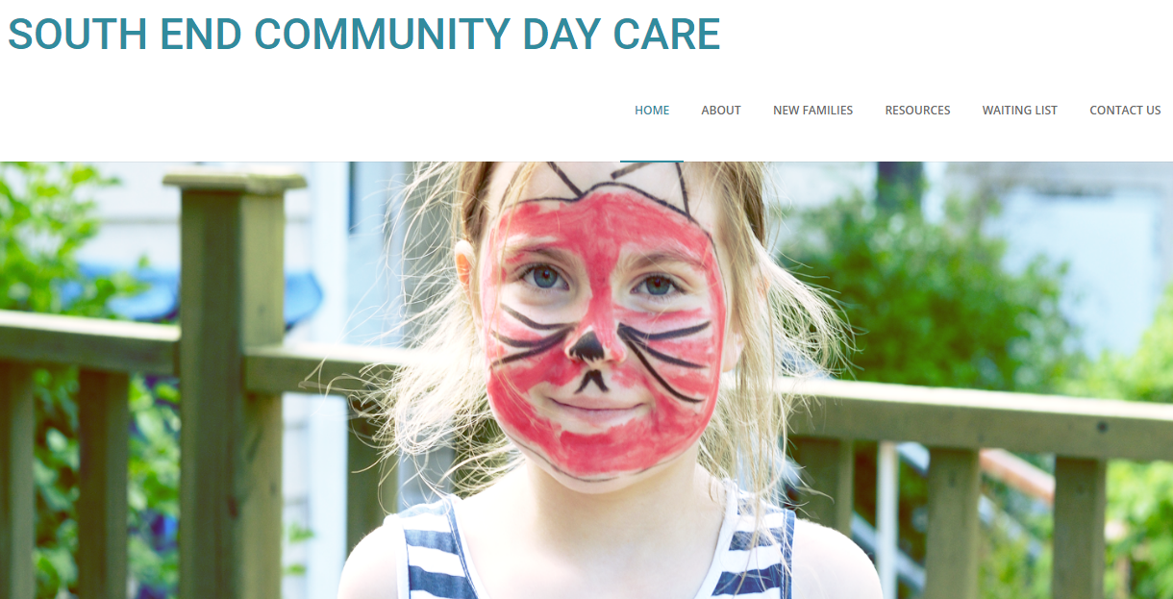
Theme

Slide 12
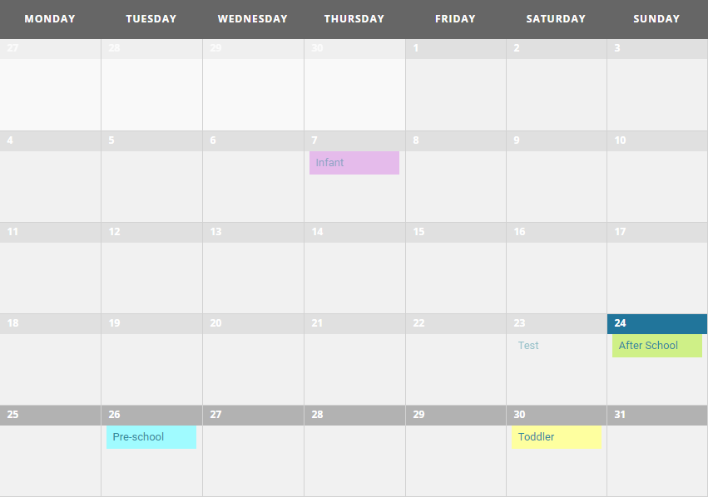
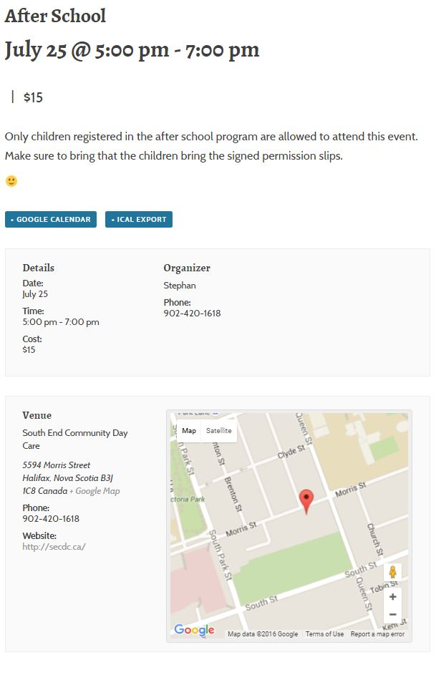
Events Calendar

Slide 13
Medical Records Management Report

Slide 14
File Sharing Recommendations Report

Slide 15
Training and Deployment

Slide 16
Documentation Overview

Slide 17
Questions?

